Slide 1


POSE DETECTION USING DEEP LEARNING
-> CB.SC.U4AIE24101 - Aakas G S
-> CB.SC.U4AIE24141 - Neeraj T
-> CB.SC.U4AIE24142 - Nithin K
-> CB.SC.U4AIE24146 - Puneeth K
2025

Slide 2
INTRODUCTION
MediaPipe BlazePose is a key point detection model that detects 33 keypoints on the human body with high accuracy. It acts as a powerful keypoint detector, providing detailed landmark coordinates that can be used for further analysis or application-specific tasks.
->Building on BlazePose, We developed a customized pose detection system by incorporating mathematical formulas to process the detected keypoints. These formulas analyze the spatial relationships between the landmarks, enabling precise classification of specific poses such as the T-pose. By calculating positional alignments and distances between keypoints, the system identifies when the body matches the T-pose posture and outputs the corresponding result.

Slide 3
Objective
To develop a pose detection system leveraging pre-trained models for accurately identifying, analysing, and evaluating human poses, with a focus on improving performance in gaming and gym workouts. The system aims to ensure real-time tracking of posture and stance, facilitating the correction of gym exercises for optimal form, reducing the risk of injuries, and enabling effective rep counting to enhance workout efficiency

Slide 4
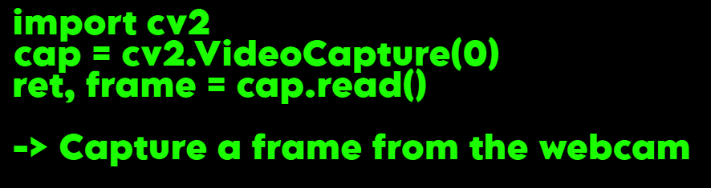
Methodology of how human skeletal detection works
Pose detection involves identifying and tracking the key points (or landmarks) of a human body in an image or video. It works by analyzing the image, locating specific body parts like joints (e.g., elbows, knees, wrists), and mapping out the pose in terms of coordinates for those points.
1
1. Input Image :
The process starts with an input image or video frame containing a person . The algorithm will focus on detecting human body parts and their spatial relationships(distances).

Slide 5
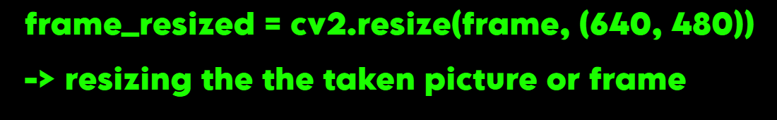
Resizing (Preprocessing)
To ensure efficient and consistent processing, the input image is resized
to a smaller, fixed size (commonly 640x480 pixels). This helps the pose detection model perform faster and more accurately, especially for real-time applications like video streams.
Why Resize: Resizing standardizes input dimensions and optimizes the model's speed without losing too much accuracy.
2
Higher resolutions may provide more detail but require significantly more processing power, increasing latency in real-time applications.
Lower resolutions reduce computational load but may lose critical details needed for accurate pose estimation

Slide 6
3
Converting to RGB Model:
MediaPipe's Pose model requires images in the RGB color space (not BGR, which is OpenCV's default). Therefore, the image needs to be converted from BGR to RGB.
Why Convert: The underlying MediaPipe model expects RGB images for processing. OpenCV uses BGR by default, so the conversion step ensures compatibility with MediaPipe.
4
Pass Through MediaPipe Pose Model:
Once the image is resized and converted to RGB, it is passed to the MediaPipe
Pose model. The model then processes the image and attempts to detect
human body landmarks.(Human Skeletal structure)
Model: Media Pipe Pose uses a deep learning model (BlazePose) that has been trained to detect key points on the human body, like the elbows, knees, shoulders, and more. In total, the model detects 33 keypoints (such as wrists, ankles, elbows, etc.).
How the model works: The model identifies key points by looking at the relationships between neighboring pixels in the image to find patterns that correspond to body parts(lightweight CNN).

Slide 7
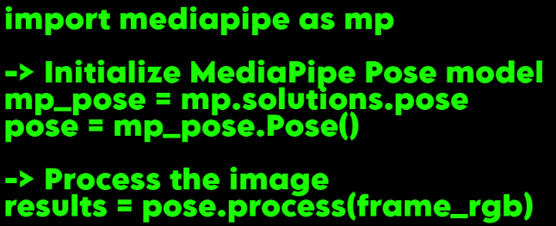
5
Model Outputs - Body Landmarks
The model outputs a list of landmarks, which are key points on the body (for example: left shoulder, right knee, nose, etc.). These landmarks come with coordinates (x, y, z) in the image, as well as a confidence score.
Landmarks: For each detected key point (like the wrist or knee), the model gives the coordinates and confidence level of the detection.
Confidence Score: A score indicating how confident the model is about the position of each key point.

Slide 8
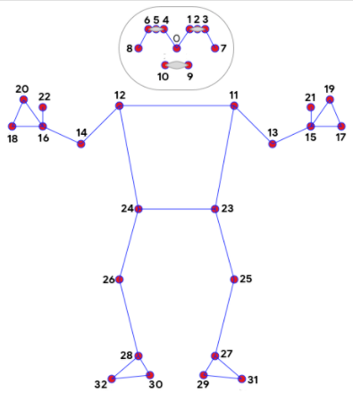
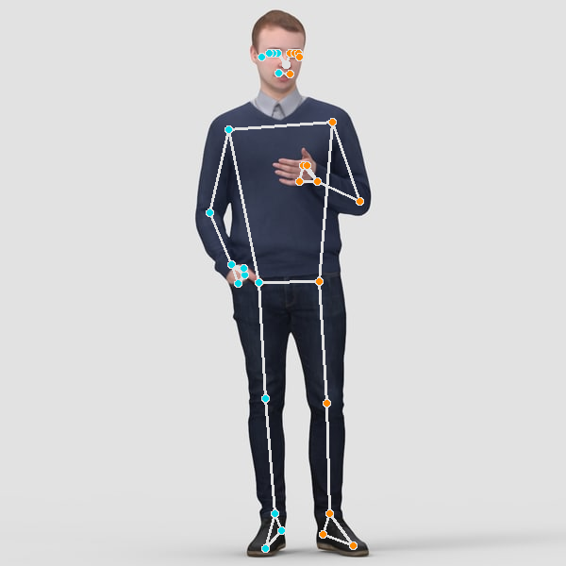
The pose_landmarks object will contain the coordinates of 33 body keypoints (such as x, y, z positions) for the person in the image.
Result of code 1 :

Slide 9
Post-processing: Visualization of Skeletal
Structure
After the model detects the keypoints, we typically
want to visualize the detected body pose. This is done by drawing the
landmarks on the original (resized) image and connecting them to form
the skeletal structure.
Drawing Landmarks: The landmarks are visualized as dots on the image, and lines (connections) are drawn between key points to create a skeleton structure.
6
POSE_CONNECTIONS: This refers to the set of connections between the keypoints to form the skeleton, such as drawing lines from the shoulder to the elbow, and from the knee to the ankle.
Result: You now have an image with overlaid points and connections, forming a skeleton.

Slide 10
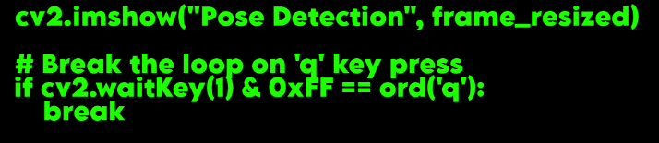
Output the Result:
After the skeletal structure is drawn, the final image (with the skeleton overlay) can be displayed or saved.by this code for mediapipe.
7

Slide 11
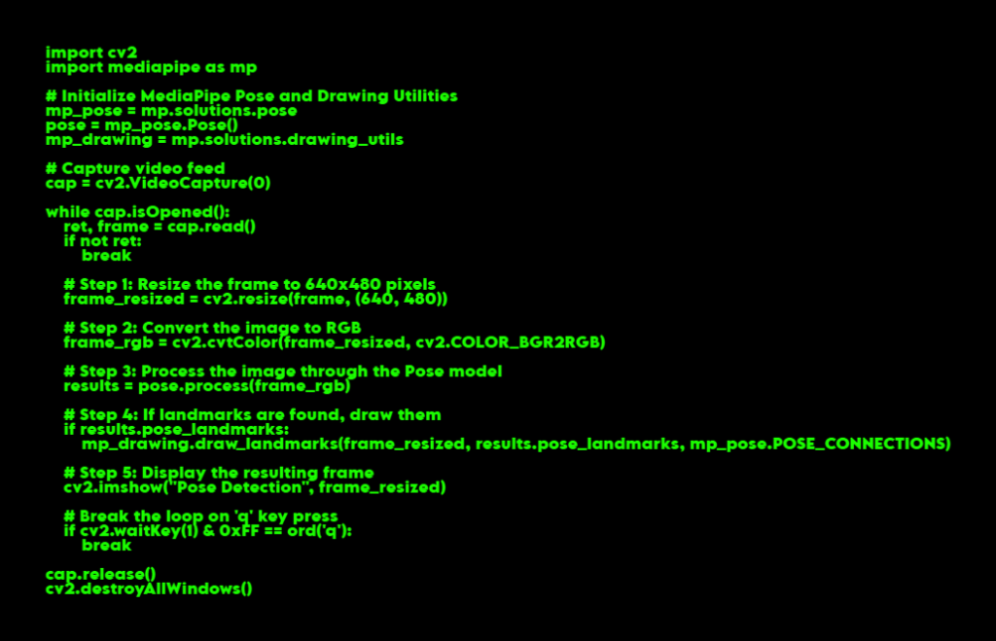
Basic code implimentation without pose detection

Slide 12
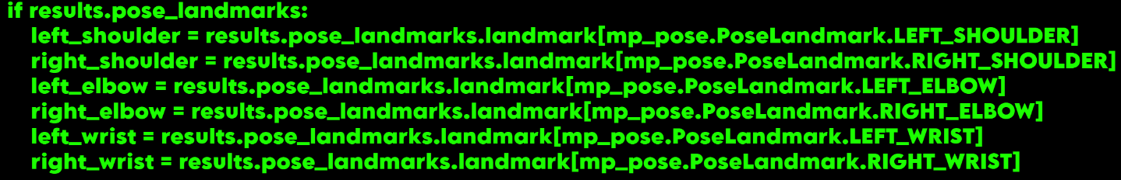
Doing pose detection for T-pose:
1
Land marks required for T-pose detection
Left shoulder (landmark 11)
Right shoulder (landmark 12)
Left elbow (landmark 13)
Right elbow (landmark 14)
Left wrist (landmark 15)
Right wrist (landmark 16)
Extracting required landmark coordinates:

Slide 13
T-Pose Detection Logic:
To detect a T-pose, we need to check the following conditions based on the positions of the arms:
The shoulders should be approximately aligned horizontally.
The elbows should be near the sides of the torso.
The wrists should be extended out horizontally, near the same y-coordinate as the elbows, and the difference in the x-coordinates between the shoulders and wrists should be significant.
T-Pose Condition:
Shoulders should be roughly aligned at the same vertical level (y-coordinates).
Elbows and Wrists should be near the same height (y-coordinates).
Wrist positions should be significantly farther apart along the x-axis
2

Slide 14
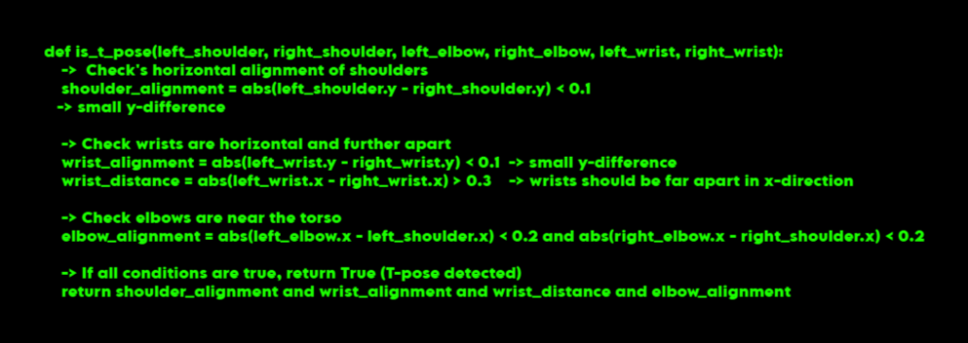
Here’s what each condition does:
Shoulder alignment: Ensures that the shoulders are roughly level (y-coordinates).
Wrist alignment: Ensures the wrists are horizontally aligned (small difference in y).
Wrist distance: Ensures the wrists are far apart (indicating extended arms).
Elbow alignment: Ensures that the elbows are near the torso (not too far outward).

Slide 15
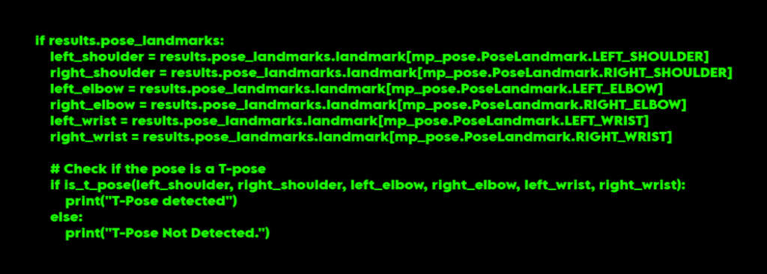
Displaying for T-Pose:
After calculating the conditions, Displaying “T-Pose detected”, if t-pose is detected

Slide 16
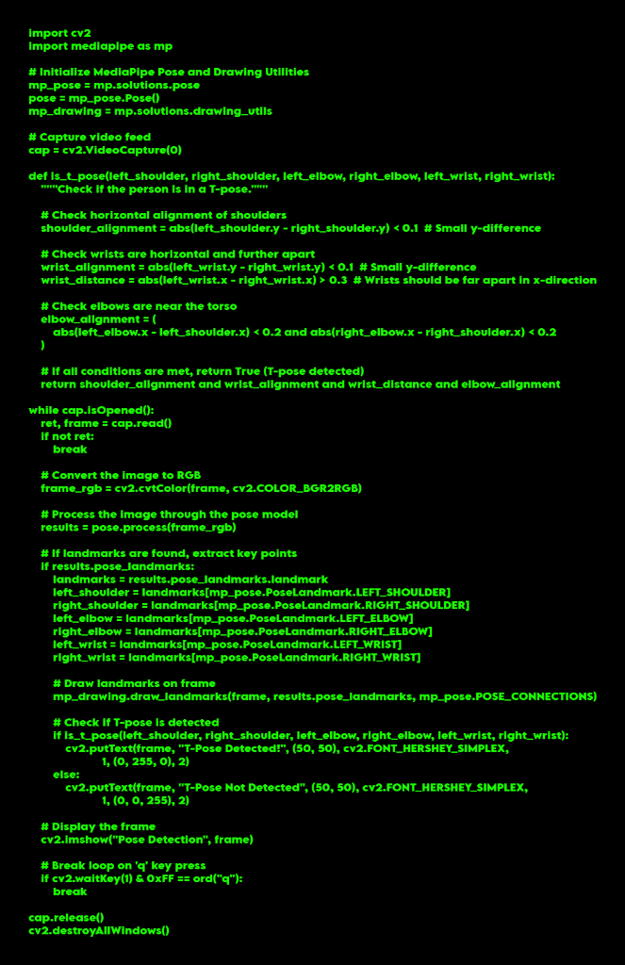
full code for Displaying for T-Pose:

Slide 17
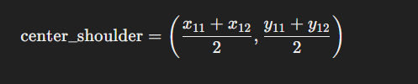

Algorithm
Pose Detection & T-Pose Transformation in MediaPipe
Pose Detection in MediaPipe
MediaPipe uses BlazePose to detect 33 body keypoints in real-time
Detects the position of these keypoints in 2D or 3D space.
T-Pose Transformation
-> Identify Key Landmarks: Focus on shoulders and elbows (Landmarks 11-14).
->Center Shoulders: Calculate the midpoint between the left and right shoulders.
->Rotate Elbows: Apply a rotation matrix to align elbows horizontally (90°).
->Adjust Wrists: Scale the wrist positions from the elbow for full extension.
->Final Pose: Resulting pose aligns arms in a T-shape.

Slide 18
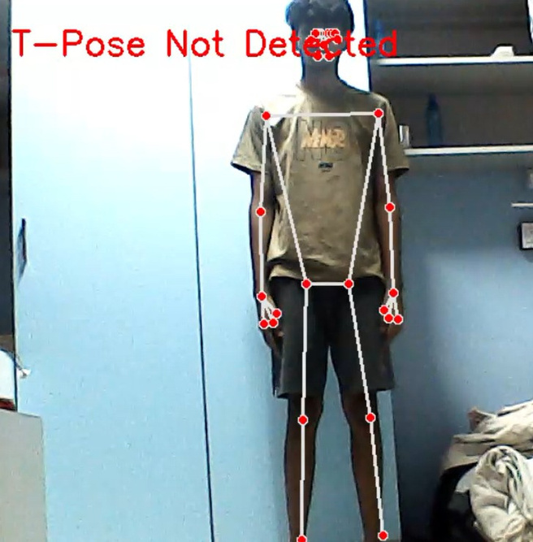
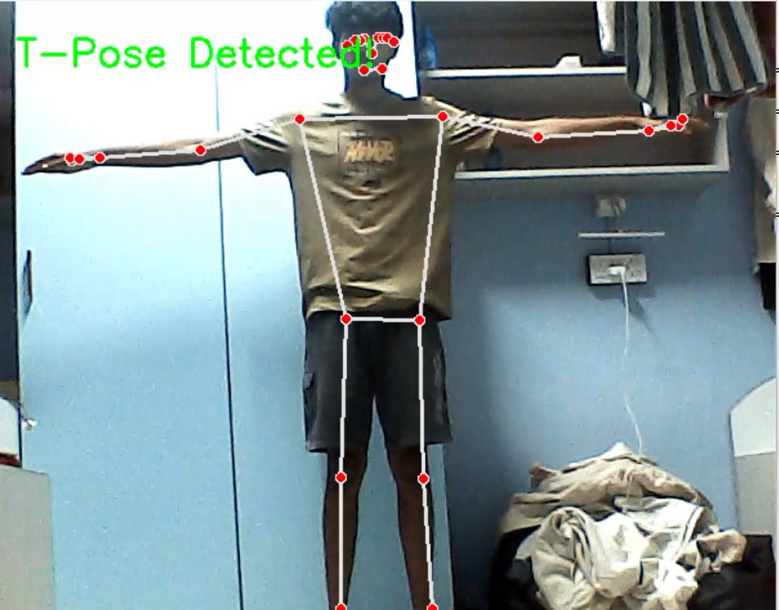
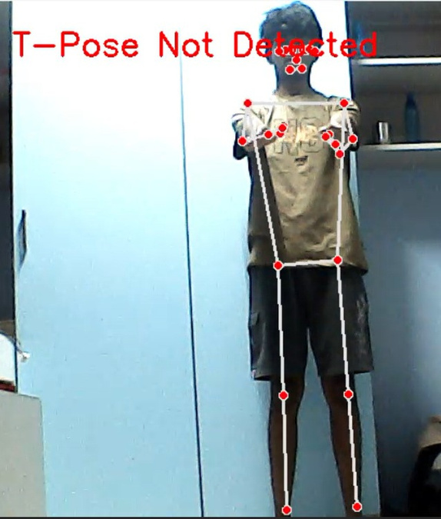
Result for T-pose detection:
• Even though pose detection algorithms achieve 100% accuracy in ideal conditions, they still struggle to detect poses accurately under challenging scenarios, such as in very bright lighting or when the angles are not clearly visible."

Slide 19
Future scope
->Fitness Tracking & Analysis
Precise Movement Detection: Track body movements during exercises (e.g., squats, push-ups, lunges).
Rep Counting: Automatically count reps based on body pose and motion.
Range of Motion Measurement: Measure flexibility and joint angles to assess exercise performance.
->Immersive Gaming Experience:
• Players control in-game avatars through physical actions like running, jumping, or using virtual
weapons, creating an interactive experience.
• Cross-Platform Compatibility:
Develop the app for mobile devices, VR headsets, or PC gaming to reach a wide range of
players.

